Slide 1
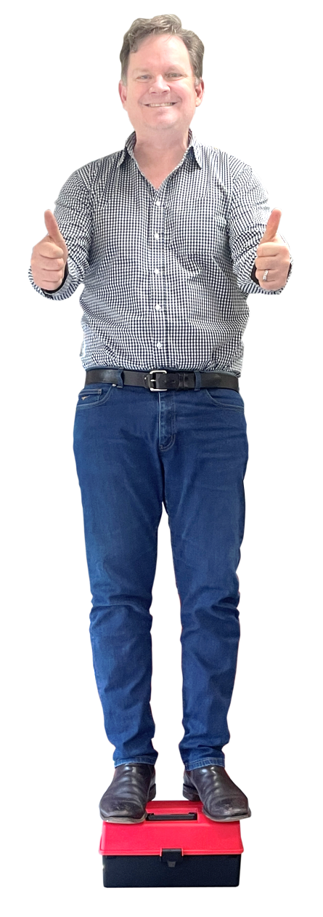
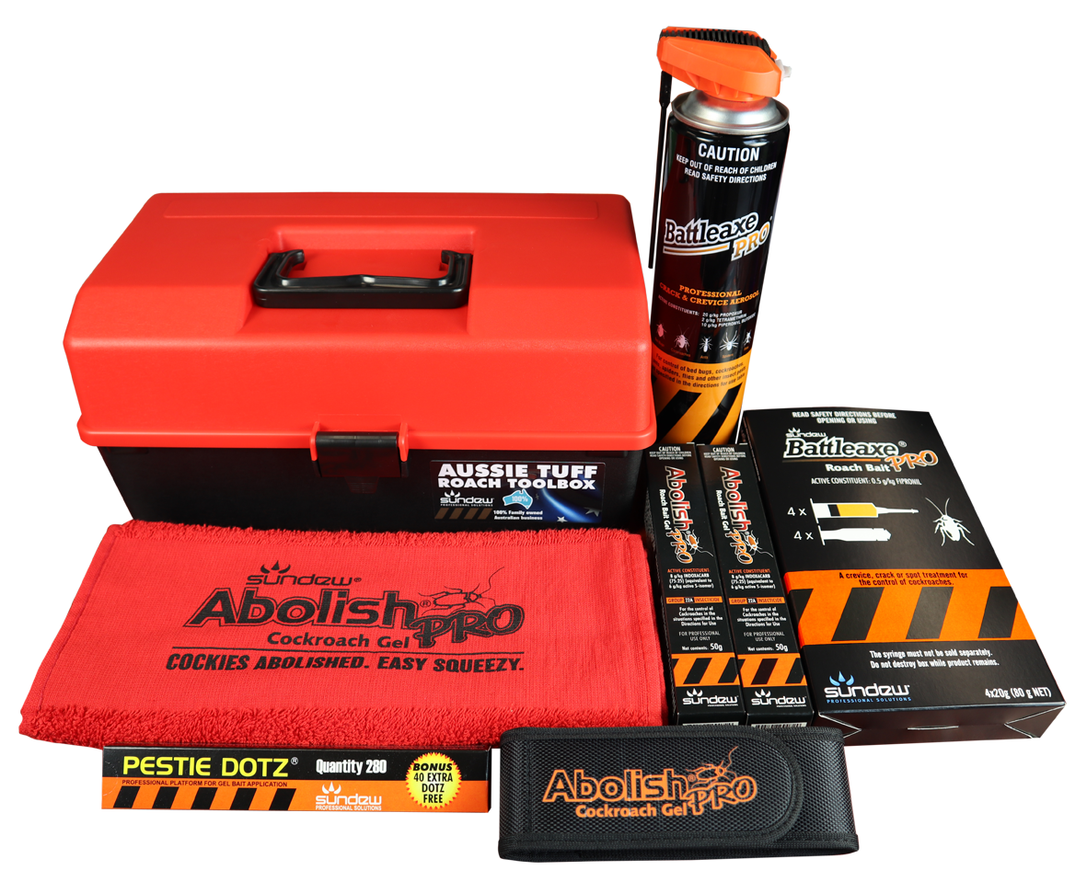
AUSSIE TUFF
ROACH TOOLBOX
SPECIAL
$169.50+gst
Valued over $225.00+gst
Includes:
2 x AbolishPRO Gel
1 x BattleaxePRO Aero
4 x BattleaxePRO Gel
1 x Pestie Dotz Pack
FREE BONUS:
Sports Towel
Tactical Pouch
Aussie Tuff Toolbox

